Slide 1
House Recommendations for
Mr. Jacob Phillips

Slide 2
Requirements
Buy a property with:
4+ Bathrooms
Big lot area
Tennis court
Pool
Golf
Historic house
No water front
No Budget Restrictions

Slide 3
Hypothesis:
Houses on the Islands have larger lot spaces than houses on the Mainland
Renovated historic houses are more expensive than non-renovated historic houses
Houses with larger lot area have smaller basement area

Slide 4
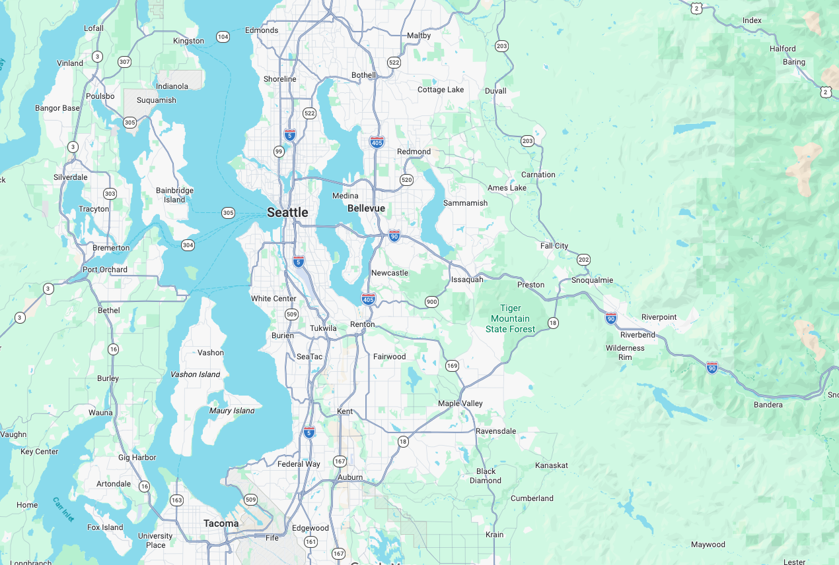
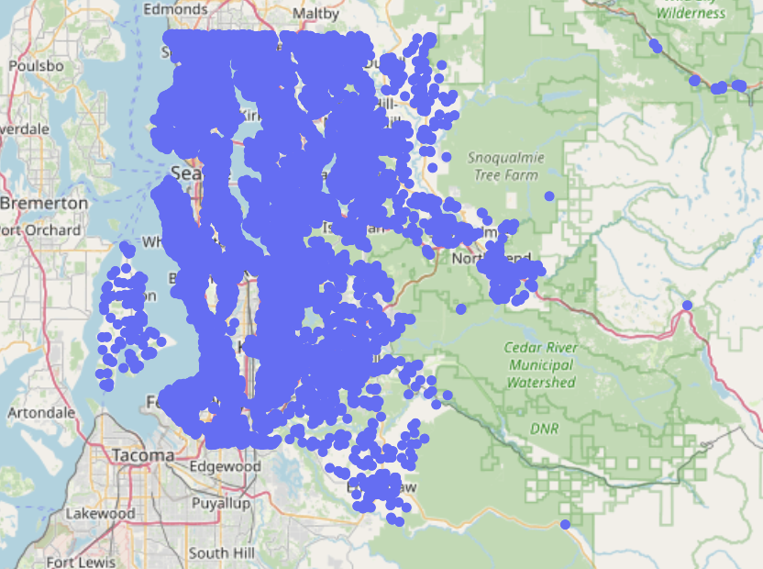
Representation of total properties in Seattle
Islands

Slide 5
Assumptions and Calculations
Any house older than 1950 is considered as Historic house.
Usually there is a 50yr rule.
The data is till 2018 so theoretically <1968
To account for errors 1950 is considered
He wants a Tennis court, Pool and Golf area
Tennis Court (Doubles Court): 7200 ft²
Pool (Sunbeds + Deck + Spa): 4800 ft²
Golf (green + chipping + bunker + hitting): 10000 ft²
Total (+30% Margin to avoid cramped feeling): 28600 ft²

Slide 6
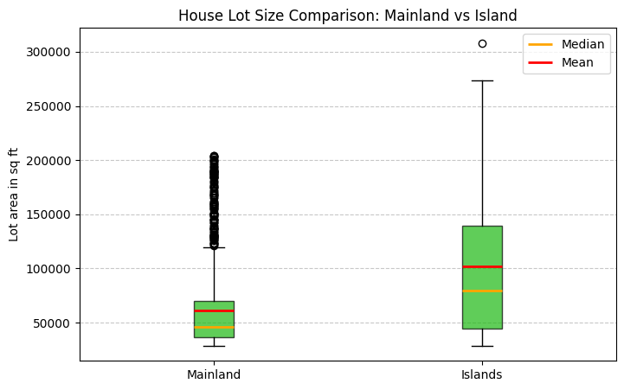
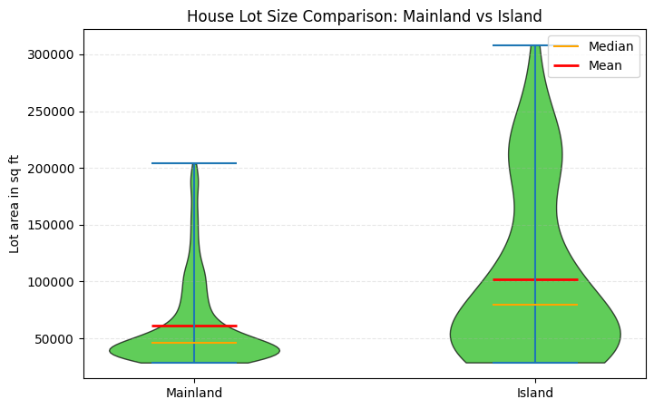
Hypothesis 1: Houses on the Islands have larger lot spaces than houses on the Mainland (Lot sizes more than 28600 ft²)
Conclusion: The initial hypothesis is valid.

Slide 7
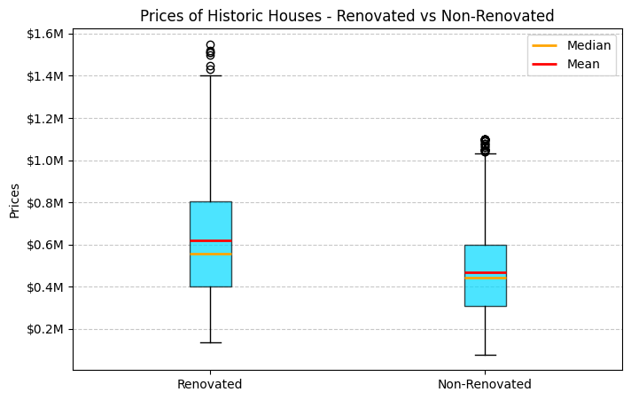
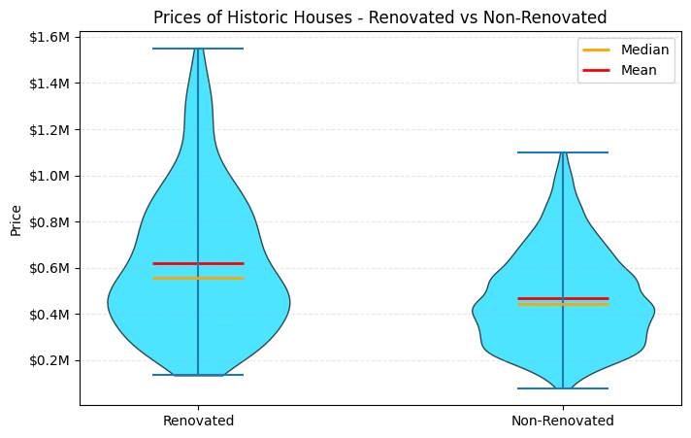
Hypothesis 2: Renovated historic houses are more expensive than non-renovated historic houses
Conclusion: The initial hypothesis is valid.

Slide 8
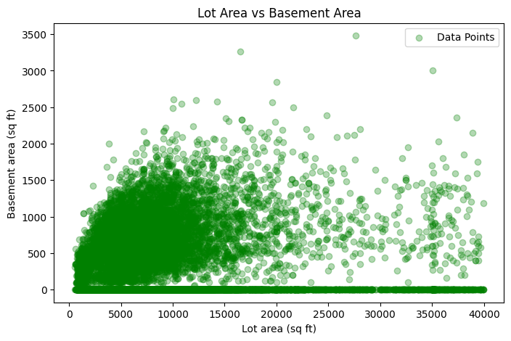
Hypothesis 3: Houses with larger lot area have smaller basement area
Conclusion: The initial hypothesis is not valid.

Slide 9
Decision Criteria:
Lot ≥ 28,600 ft²
Historic (≤ 1950)
≥ 4 bathrooms
Grade >= 11
Non-waterfront

Slide 10
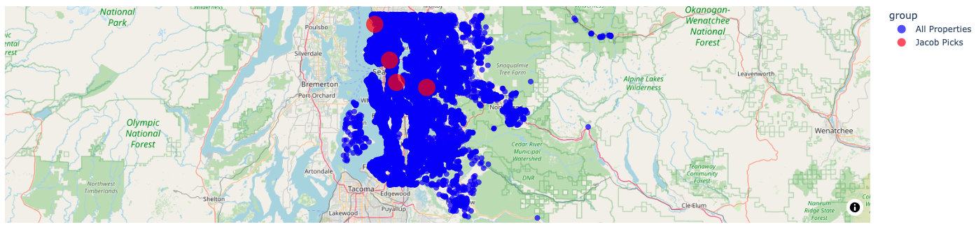
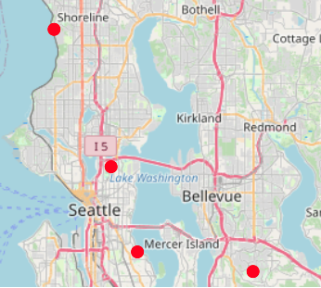
Recommendation for Jacob
House ID | Bedrooms | Bathrooms | Living Area (ft²) | Lot Area (ft²) | Floors | Waterfront | Grade | Year Built | Year Renovated | Price
3377900195 | 4 | 5.5 | 6930 | 45100 | 1 | 0 | 11 | 1950 | 1991 | $2,530,000.00
5249800010 | 4 | 4.25 | 6410 | 43838 | 2.5 | 0 | 12 | 1906 | 0 | $2,730,000.00
1333300145 | 3 | 4 | 4200 | 30120 | 2 | 0 | 11 | 1933 | 0 | $2,230,000.00
3304700130 | 4 | 4 | 3860 | 67953 | 2 | 0 | 12 | 1927 | 0 | $1,760,000.00
All properties vs shortlisted recommendations

Slide 11
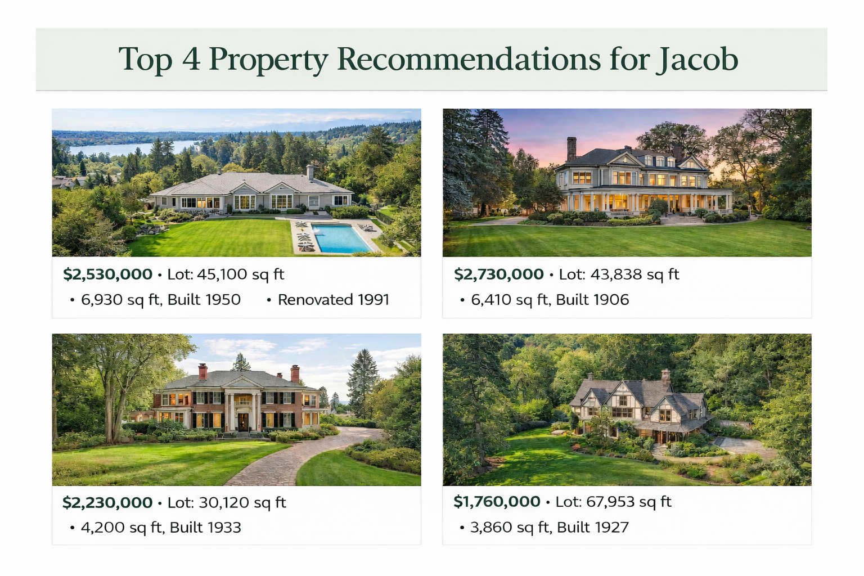
Source: Image generated by ChatGPT

